Slide 1
Word Lesson 4 Formatting Text
Microsoft Office 2010 Introductory
Pasewark & Pasewark

Slide 2
Objectives
Change the font.
Change the size, color, and style of text.
Use different underline styles and font effects and highlight text.
Copy formatting using the Format Painter.
2
2

Slide 3
Objectives (continued)
Understand styles and apply Quick Styles.
Change the theme.
Create new Quick Styles.
Clear formatting.
3
3

Slide 4
Vocabulary
attribute
color palette
font
font effect
font size
font style
Format Painter
point
Quick Style
style
text effect
theme
4
4

Slide 5
Formatting Text
Once you have typed text in a document, you can format the text to change its appearance.
In this lesson, you will learn how to change the appearance, size, color of text, and how to apply several formats at once using styles.
You will also learn how to change a document's theme and how to modify and create new styles.
5
5

Slide 6
Changing the Font
Designs of type are called fonts.
Like clothing, fonts can be dressy or casual.
To change the font, locate the Font group on the Home tab on the Ribbon. Click the arrow next to the Font box, and then scroll to the font of your choice.
6
6

Slide 7
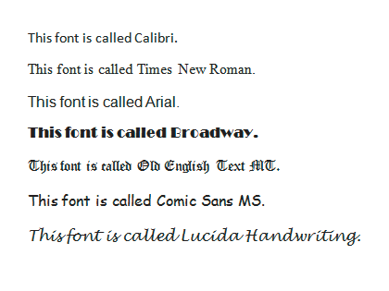
Changing the Font (continued)
Examples of different fonts

Slide 8
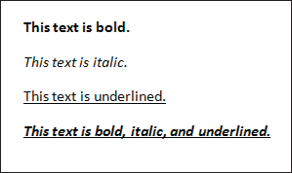
Changing Font Attributes
Once you have decided on a font, you can change its attributes, or how it looks.
For example, you can change the size of the font or change its style by making the font bold, italic, or underlined. You can also add color and apply special effects.
Examples of font styles
8
8

Slide 9
Changing Font Attributes (continued)
Font size is determined by measuring the height of characters in units called points.
Standard font sizes for text are 10, 11, and 12 points.
To change text color, click the arrow next to the Font Color button on the Home tab. This opens a gallery that includes a coordinated set of colors called the color palette.
9
9

Slide 10
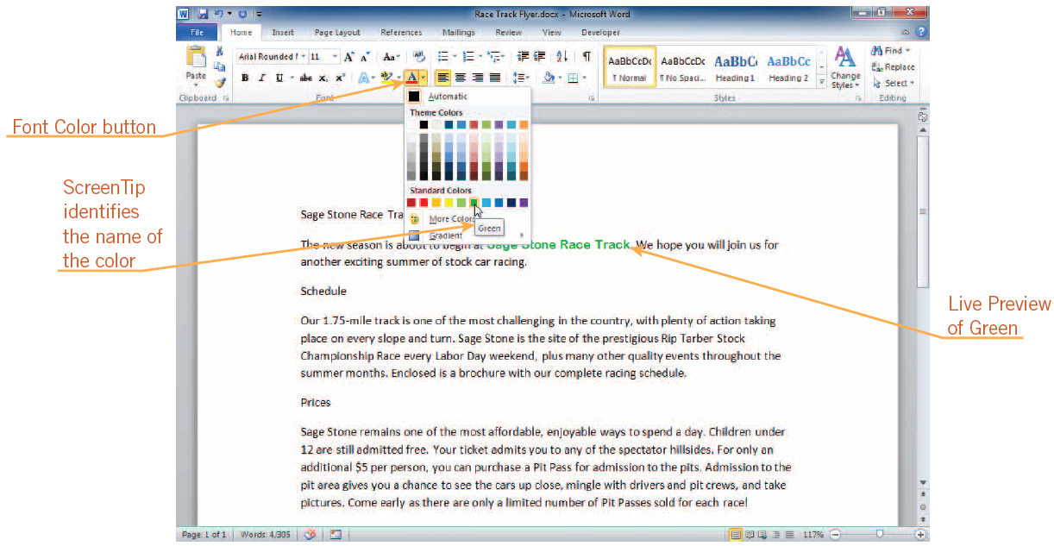
Changing Font Attributes (continued)
Color palette on the Font Color button gallery
10
10

Slide 11
Changing Font Attributes (continued)
You can apply a font style to a font to change its appearance. Common font styles are bold, italic, and underlining.
The Bold, Italic, and Underline buttons are on the Home tab.
You can underline text with one line, multiple lines, dotted lines, dashed lines, or another style. You can also change the color of the underline.
11
11

Slide 12
Changing Text Effects
Text effects, also called font effects, are similar to font styles and can help enhance or clarify text.
To apply a text effect, such as strikethrough, subscript, or superscript to selected text, click the button corresponding to that effect on the Home tab.
12
12

Slide 13
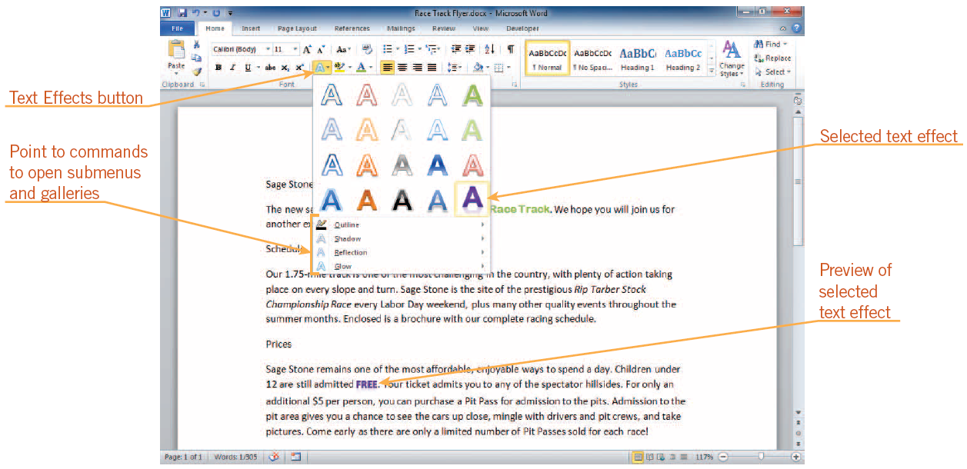
Changing Text Effects (continued)
Text Effects button gallery and menu

Slide 14
Highlighting Text
To highlight text, click the arrow next to the Text Highlight Color button in the Font group on the Home tab.
If text is selected, the text becomes highlighted with the color you chose.
If no text is selected, the pointer changes to the Highlight pointer, an I-beam pointer with a marker on it, when positioned over text.
14
14

Slide 15
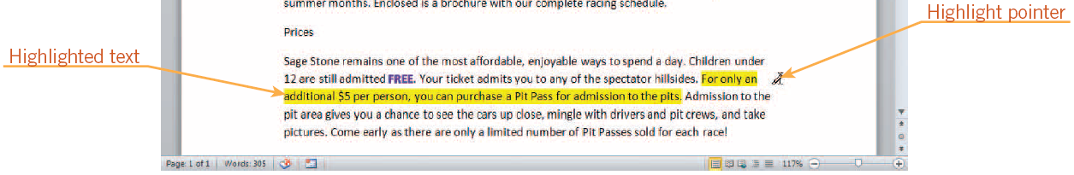
Highlighting Text (continued)
Text highlighted with the Highlight pointer

Slide 16
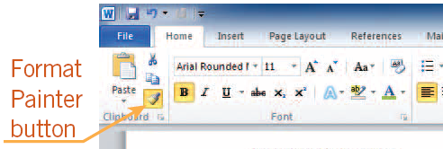
Copying Formatting
You can copy the format of selected text to other text by using the Format Painter.
Click the Format Painter button on the Home tab or on the Mini toolbar.
To copy the format to more than one block of text, double-click the Format Painter button.
16
16

Slide 17
Understanding Styles
In Word, a style is a set of formatting options that have been named and saved.
Using styles can save time and add consistency to a document.
Character styles affect only selected text; paragraph styles affect entire paragraphs.
17
17

Slide 18
Applying Quick Styles
A Quick Style is a style that is available by clicking a button in the Styles group on the Home tab.
When the Quick Styles gallery is open, you can point to a Quick Style to see a Live Preview of the formatting in the document.
The default style for text is the Normal Quick Style.
18
18

Slide 19
Changing Themes
A theme is a coordinated set of fonts, styles, and colors.
To see the available themes, click the Page Layout tab, and then, in the Themes group, click the Themes button.
Quick Style definitions and the fonts used in a document are tied to the theme.
19
19

Slide 20
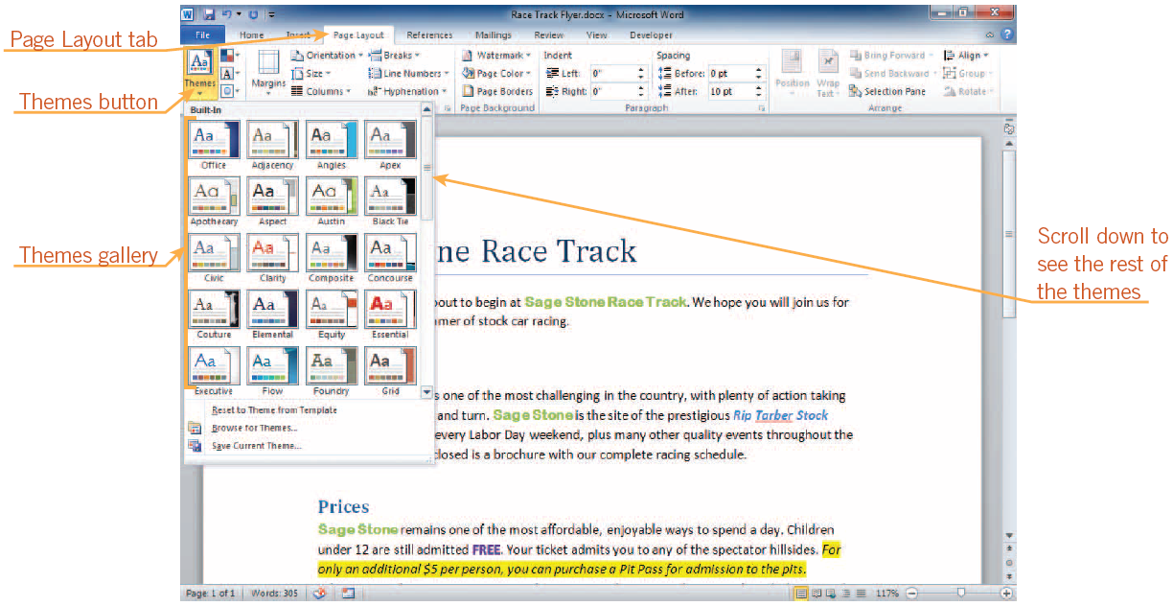
Changing Themes (continued)
Themes gallery

Slide 21
Redefining an Existing Quick Style
The easiest way to create your own style is to format text with an existing Quick Style, and then make changes until you are satisfied with the final look.
To redefine an existing Quick Style, select the formatted text, right-click the Quick Style you want to redefine to open a shortcut menu, and then click the Update command.
21
21

Slide 22
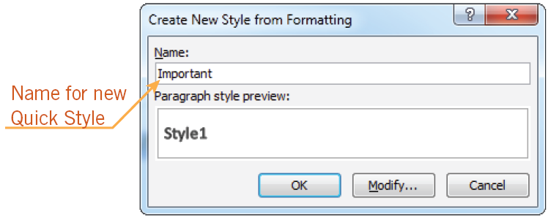
Creating a New Quick Style
The easiest way to create a new Quick Style is to first format text with the font, style, and any other characteristics that you want.
You can then name and add your style to the Quick Styles gallery.
Create New Style from Formatting dialog box
22
22

Slide 23
Clearing Formatting
You can use the Clear Formatting command to remove manual formatting and styles.
When you remove a style, the Normal Quick Style is automatically applied.
23
23

Slide 24
Summary
In this lesson, you learned:
Fonts are designs of type that can be used to change the appearance of a document.
Font size is measured in points. The higher the point size, the larger the characters.
Common font styles are bold, italic, and underline. These styles can be applied to any font. You can change the color and style of underlines.
24
24

Slide 25
Summary (continued)
The look of text can be changed by changing its color and adding text effects.
Highlighting can be used to emphasize important text.
The Format Painter copies the format and style of blocks of text.
Styles are predefined sets of formatting options that save time and add consistency to a document. A Quick Style appears in the Styles gallery on the Home tab.
25
25

Slide 26
Summary (continued)
A theme is a coordinated set of fonts, styles, and colors. When you change the theme, all text that has a Quick Style applied to it, including the Normal Quick Style, changes to the fonts, colors, and styles in the new theme.
You can create new Quick Styles by redefining existing Quick Styles or by creating an entirely new Quick Style.
The Clear Formatting command clears all formatting and styles from selected text.
26
26

